Slide 1
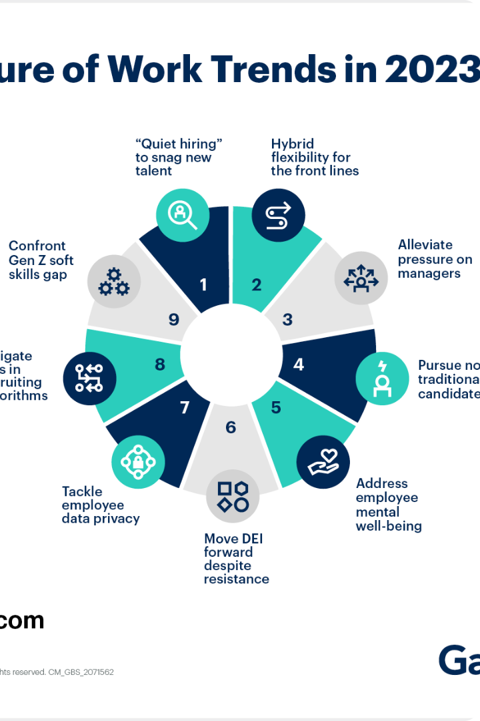
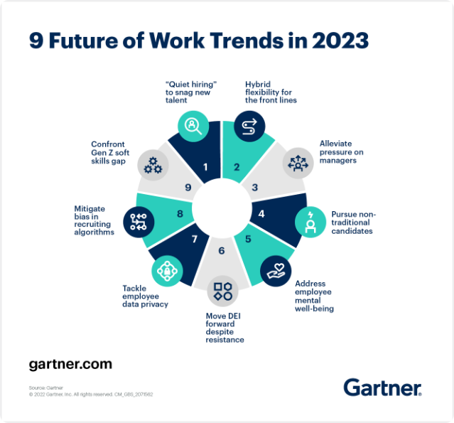
Top 10 Business Trends to Watch in 2024
As we look ahead to 2024, the business landscape is set to undergo significant transformations driven by the rapid advancements in technology, evolving consumer preferences, and the lasting impacts of the pandemic. Staying ahead of these trends will be crucial for companies to remain competitive and responsive to the changing market dynamics.

Slide 2
Artificial Intelligence and Automation
AI-Powered Automation
Businesses will increasingly leverage AI-driven automation to streamline operations, enhance efficiency, and reduce costs.
Machine Learning
Machine learning algorithms will be deployed to make data-driven decisions, personalize customer experiences, and predict market trends.
Intelligent Chatbots
Conversational AI chatbots will become more sophisticated, providing seamless customer support and personalized interactions.

Slide 3
Sustainability and Environmental Consciousness
Eco-Friendly Products
Renewable Energy
Circular Economy
Consumers will demand more sustainable and environmentally responsible products, driving businesses to rethink their manufacturing and supply chain processes.
The adoption of renewable energy sources, such as solar and wind, will continue to accelerate as businesses seek to reduce their carbon footprint.
Businesses will embrace the principles of the circular economy, focusing on reusing, recycling, and repurposing materials to minimize waste.

Slide 4
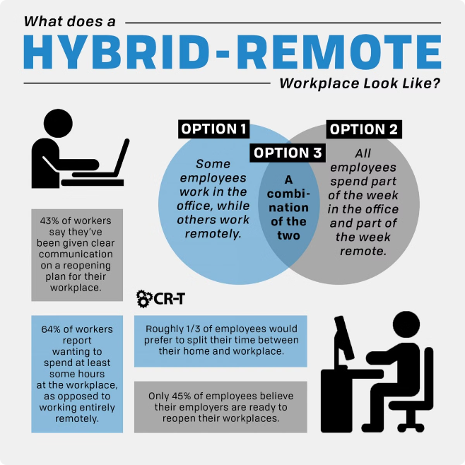
Remote and Hybrid Work Models
1
Remote Work
The pandemic has accelerated the adoption of remote work, allowing companies to access a global talent pool and reduce overhead costs.
2
Hybrid Workplace
Businesses will increasingly embrace a hybrid work model, blending remote and in-office work to provide flexibility and promote collaboration.
3
Employee Well-being
Companies will focus on supporting the physical and mental well-being of their remote and hybrid workforce through wellness programs and technology-enabled solutions.

Slide 5
Personalized Customer Experiences
Data-Driven Insights
Businesses will leverage data analytics and AI to gain deeper insights into customer preferences and behaviors, enabling them to deliver highly personalized experiences.
Omnichannel Engagement
Companies will seamlessly integrate various touchpoints, such as online, in-store, and mobile, to provide a consistent and personalized customer journey.
Hyper-Personalization
Customized products, services, and recommendations will become the norm as businesses strive to meet the individual needs of each customer.
Empathetic Approach
Businesses will prioritize empathy and emotional intelligence to better understand and cater to the unique needs and preferences of their customers.

Slide 6
Blockchain and Cryptocurrency Adoption
Decentralized Finance
Blockchain technology will enable the development of decentralized financial services, including digital payments, lending, and asset trading.
Cryptocurrency Mainstream
More businesses will accept cryptocurrencies as a legitimate form of payment, leading to increased mainstream adoption and integration.
Smart Contracts
Blockchain-based smart contracts will automate various business processes, enhancing transparency, efficiency, and security.

Slide 7
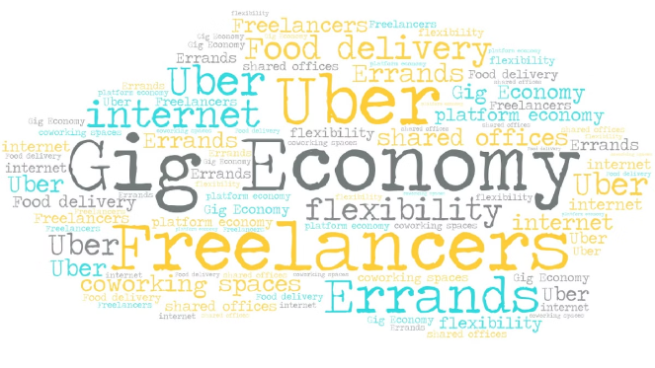
Gig Economy and Freelance Workforce
1
Flexible Talent Pools
Businesses will increasingly turn to freelancers and gig workers to access specialized skills and adaptable workforce models.
2
Remote Collaboration
Advanced collaboration tools and digital platforms will enable seamless remote coordination between companies and their freelance workforce.
3
Skill-Based Hiring
Companies will focus on hiring based on specific skills and competencies rather than traditional employment structures.
4
Workforce Optimization
Businesses will leverage the gig economy to optimize their workforce and adapt to changing market demands.

Slide 8
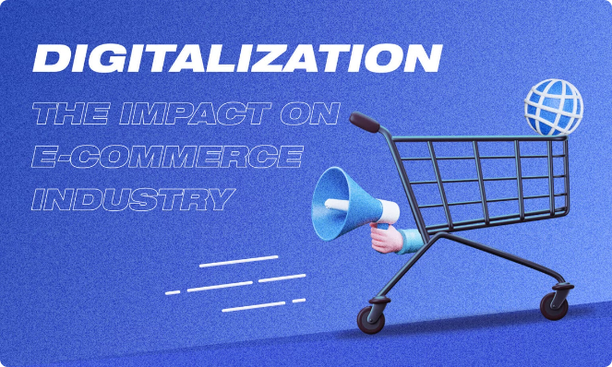
Digitalization and E-commerce Acceleration
Omnichannel Retail
Seamless integration of online and offline sales channels to provide a cohesive shopping experience.
Immersive E-commerce
Adoption of technologies like augmented reality and virtual reality to enhance online shopping experiences.
Data-Driven Optimization
Leveraging data analytics to optimize digital marketing strategies, inventory management, and supply chain logistics.
Contactless Experiences
Contactless payments, curbside pickup, and touchless interactions to meet evolving consumer preferences.

Slide 9
Workforce Upskilling and Reskilling
Adaptable Skills
Lifelong Learning
Collaboration and Innovation
Businesses will invest in upskilling and reskilling programs to help their employees acquire new, in-demand skills and adapt to technological changes.
Employees will be encouraged to continuously learn and develop new competencies to remain relevant and competitive in the job market.
Cross-functional teams and collaborative learning environments will foster innovation, problem-solving, and the exchange of knowledge within organizations.

